Slide 1
Memory Management Module 5
Operating Systems

Slide 2
Chapter Outline
Memory
Memory hierarchy
Process loading and swapping
Memory management
Memory allocation methods
Storage management strategies
Contiguous memory allocation
Non-contiguous memory allocation
Paging
Simple paging
Implementation of paging
Segmentation
Simple segmentation
Segment addressing

Slide 3
Memory
Used for storage and retrieval of data and instructions
Essential component
Logically memory system can be divided into three groups
Internal memory
Set of registers in processor
they hold temporary results during execution
Main memory
Communicates directly with CPU
Secondary (external memory)
Peripherals storage devices such as disk and tape etc

Slide 4
Memory Hierarchy
Registers
Cache
Main memory
Magnetic disk
Magnetic tape
Capacity
Speed & Cost

Slide 5
Memory Hierarchy
Registers
are fastest, smallest and most expensive
Main memory
It is principal memory
It is generally extended with a higher speed smaller cache
Used to improve movement of data between main memory and processor registers
Usually not visible to user or programmer or indeed to the processor
External devices are permanent storage
Also referred as secondary or auxiliary memory
e.g. magnetic disk, tape, hard disk

Slide 6
Process Loading & Swapping
Process loading
Transfer of a process from secondary storage to main memory
Process Swapping
Transfer of a process from memory to secondary storage

Slide 7
Memory Management
Memory is a volatile array of words or bytes, shared by the CPU and I/O devices
Programs must be brought into memory and place in form of a process to be executed
The operating system manages the memory activities
Keep track of which parts of memory are currently being used and by whom
Decides which process(s) to load when memory space becomes available
Allocate and de-allocate memory space to processes as required

Slide 8
Address Binding
Address binding is the process of mapping logical addresses generated by a program to physical addresses in main memory, carried out at compile-time, load-time, or execution-time.
CPU (logical address)
↓
MMU (binding/mapping)
↓
RAM (physical address)

Slide 9
Address Binding
1. Compile-Time Address Binding
Binding happens during program compilation.
Logical address = physical address.
Program must load at a specific memory location.
If location changes, program must be recompiled.
Rarely used.
Example: Embedded systems.
2. Load-Time Address Binding
Binding happens when the program is loaded into memory.
Compiler generates relocatable code.
Physical address decided by OS loader.
If address changes → no need to recompile, just reload.

Slide 10
Address Binding
3. Execution-Time Address Binding (Run-Time Binding)
Binding happens while program is running.
Requires hardware support such as MMU (Memory Management Unit).
Allows processes to move in memory during execution (swapping/relocation).
Used in modern OS and virtual memory systems.
Important Concepts
Logical Address: Generated by CPU (virtual address).
Physical Address: Actual location in RAM.
MMU (Memory Management Unit): Hardware that converts logical → physical address at runtime.

Slide 11
Logical vs. Physical Address Space
Logical address
Generated by CPU
Also referred to as virtual address
Physical address
Address seen by the memory unit
Compile and load time binding
Logical = physical memory
Execution time binding
Logical is virtual memory, i.e. does not necessarily coincide with physical memory

Slide 12
Virtual Addresses
There exist a set of memory addresses that programs can produce
These program generated addresses are called virtual or logical addresses and form virtual address space
Physical addresses are the addresses seen by the memory unit
Logical and physical addresses are same at compile time
Logical and physical addresses differ in execution time
Why Virtual Address is Used?
To give each process its own memory space
To enable memory protection
To support paging & segmentation
To allow programs larger than RAM (virtual memory)
To allow relocation & swapping

Slide 13
Memory Management Unit
Hardware device that maps virtual address to physical address
Use a base or relocation register
The value in relocation register is added to every address generated by a user process at the time it is sent to memory
The user programs deals with logical addresses
It never sees the real physical addresses
Why is MMU Needed?
MMU provides:
Virtual memory
Memory protection
Relocation
Paging & segmentation
Swapping support
Isolation between processes
Without MMU, CPU would directly use physical addresses → no security, no virtual memory.

Slide 14
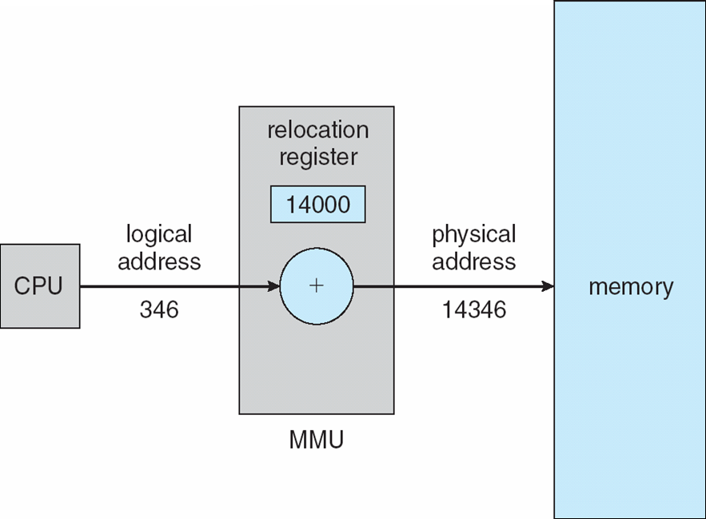
Memory Management Unit
Program executes an instruction that references address 346 — this is the logical address (an offset within the program’s address space).
MMU reads the relocation/base register value = 14000. That value is the physical address where the process’s logical address 0 is mapped.
MMUcomputes: Physical address = Base + Logical → 14000 + 346 = 14346.
The memory system uses physical address 14346 to fetch/store the requested data.

Slide 15
Memory Management Requirements
1. Relocation
Main memory is shared between processes
Swap active processes in and out to provide large pool of ready processes
Quite difficult to declare when swapped out process will be placed back
A process image occupies a contiguous region of main memory
To run this process, the processor hardware and operating system must be able to translate the memory reference found in code, into physical memory address

Slide 16
Memory Management Requirements
2. Protection
Each process must be protected by unwanted interference by other processes
Without prior permission, a process should not refer to other process
All memory references generated by a process must be checked at run time
to ensure that they refer only to the allocated memory space
The processor must abort such instructions when executed
Thus, the memory protection requirement must be satisfied by the processor (hardware) rather than operating system
Since OS cannot anticipate all the memory references a program will make
Even if such participations are possible, it would be prohibitively time consuming to screen each program in advance for possible memory reference violation

Slide 17
Memory Management Requirements
3. Sharing
Allow several processes to access the same area of main memory
Processes that are cooperating on some tasks may need to share access the same data structure
Allow controlled access to share areas of main memory without compromising essential protection

Slide 18
Memory Management Requirements
4. Local organization
Main memory is organized as a linear or one-dimensional address space that consist of a sequence of bytes or words
Secondary memory at its physical level is similarly organized
It does not correspond to the way programs are constructed
Mostly programs are organized into modules
Some of which are un-modifiable (read or executable only)
Some of which contain that can be modified

Slide 19
Memory Management Requirements
5. Physical organization
Secondary memory of large capacity provides long term storage of program and data
While a smaller main memory holds programs and data currently in use
The organization of flow of information between main memory and secondary memory is a major system concern

Slide 20
Program Loading into Memory
The core task of any memory management system is to bring and manage programs in main memory
In almost all modern multiprogramming systems, this task involves sophisticated scheme known as virtual memory
Virtual memory is in turn based on the use of one or both of two basic techniques
Segmentation
Paging

Slide 21
Memory Management Techniques
Different schemes used in operating systems to allocate memory to processes
Contiguous Memory Allocation
Single process system
Fixed size (static) partition memory
Variable sized (dynamic) partition memory
Non-contiguous Memory Allocation
Paging
Segmentation
Variations of above
Paged segmentation
Demand paging
Demand segmentation
Virtual memory

Slide 22
Contiguous Memory Allocation

Slide 23
Single Process System
Memory is divided into two partitions
One for user process and
One for the operating system
Most common to place the operating system in low memory
Run one process at a time in high memory
Memory management is very simple
Example;
MS-DOS system is an example of this system
Unused
User
process
Operating
system

Slide 24
Fixed Sized Partition Memory
Memory is divided into several fixed partitions
Each partition may contain exactly one process
When partition is free, another process is loaded into free partition
Waste considerable amount of main memory when processes are smaller than allocated partition
Called internal fragmentation
First employed in multiprogramming computers
Used in IBM OS/360
Disadvantages
Prevent a process being run due to unavailability of sufficient size partition
Internal fragmentation wastes space

Slide 25
Fixed Sized Partition Memory
1000 K
Process C
300 K
Partition 3 = 400 K
Partition 2 = 300 K
Partition 1 = 200 K
600 K
Process B
200 K
300 K
Process A
150 K
100 K
Operating System
0 K

Slide 26
Variable-Sized Partition Memory
The processes would be given as much storage as they required
Processes are loaded into consecutive areas until the memory is filled
When a partition is free, another process is loaded into free partition
External fragmentation
It refers to the distribution of the free memory space, out-with any process allocation
What are the problems here?
What if the size of the vacant partition(s) is smaller than the size of the incoming process?
A new process cannot be started
Solution
Coalescing
It refers to combine two or more adjacent holes to accommodate a large incoming process
Difficulty: Coalescing is a time-consuming procedure

Slide 27
Variable-Sized Partition Memory
Variable partition scheme has been used successfully in many computers
Overheads
In variable partition, the system must keep track of
the position
size of each hole
taking account of the effect of coalescing
The solution is to use linked list, which contains
Pointer to the start of each hole and
The hole size

Slide 28
Variable-Sized Partition Memory
Variable-sized partition with compaction
Compaction is a process of physically moving memory resident processes to close-up the holes
Difficulty;
It is a time-consuming procedure
All processes are suspended while reshuffling takes place
Not feasible in time critical system
Compaction may be performed
As soon as any process terminates
When new process cannot load due to fragmentation
At fixed intervals
When the user decide to do

Slide 29
Storage Management Strategies
Storage management strategies are used to obtain best possible use of main memory
The strategies are divided into following categories
Fetch strategies
Placement strategies
Replacement strategies

Slide 30
Storage Management Strategies
Fetch Strategies
When to obtain the next process for transfer to main memory from secondary memory
It could be done by
Demand fetch strategies
In this next process is brought to main memory when it is referenced by running program
Anticipatory fetch strategies
In this system predicts program’s needs and attempt to load the appropriate process

Slide 31
Storage Management Strategies
Placement Strategies
Placement strategies concerned with determining where in main memory to place an incoming process
Three placement strategies are;
Best fit
Places the process in smallest of the available holes
Intuitively appealing
First fit
Places the process in first available hole, which is large enough to hold it
Low overheads
Worst fit
Places the process in the largest available hole
Another process can be accommodated if hole is big enough
Example;
A variable partition memory with hole sizes in order 20k, 15k, 40k, 60k, 10k, 25k
What if a new process of 25k is to be loaded

Slide 32
Storage Management Strategies
Replacement Strategies
They are concerned with determining which process to displace to make room for incoming process
Decision is made on different factors

Slide 33
Non-contiguous Memory Allocation
Paging & Segmentation

Slide 34
Paging
Fixed sized and variable sized partitions are insufficient due to
Internal fragmentation
External fragmentation
Paging removes these problems
Main memory is partitioned into equal fixed-size chunks called frames
Relatively small in size
Each process is also divided into fixed size chunks called pages
Same size as memory frames
Page size is typically power of 2 (typically 4K-8K)
depending on the computer architecture
No need of contiguous frames for a process or even in correct order

Slide 35
Paging
Page 1
Page 0
Page 2
Page 3
Process A
Page Table
Page 1
Page 0
Page 2
Page 3
12
13
14
15
16
17
18
19
20
21
12
13
14
15
16
17
18
19
20
21
Free frame list
14
13
18
20
15
0 | 14
1 | 13
2 | 18
3 | 20
Process A
Page 0
Page 1
Page 2
Page 3

Slide 36
Page Addressing
page number
page offset
p
d
1. What is Page Addressing?
In paging, memory addresses are divided into:
Page Number (p): Identifies which page of the process the address belongs to.
Page Offset (d): Identifies the exact location within that page.
Logical addresses are translated to physical addresses using the page table.
m - n
n
2. Logical Address Structure
Suppose a process has:
Logical address space: 0 to 4095 (i.e., 12-bit address)
Page size: 1024 bytes (2¹⁰)
Then:
Page number (p): 2 bits (since 4 pages needed: 0–3)
Page offset (d): 10 bits (0–1023 within each page)
Example:
Logical address = 2500
Page size = 1024
Page number = 2500 / 1024 = 2
Page offset = 2500 % 1024 = 452

Slide 37
Address Translation Using Page Table
Steps:
CPU generates logical address (p, d).
Page table is consulted to get the frame number (f) for page p.
Physical address = (frame number × frame size) + page offset
Example:
Page table:
Information:
Logical Address: (Page Number, Offset)
Physical Address: (Frame Number, Offset)
Translation: Physical Address = Frame × Frame Size + Offset
Paging allows non-contiguous allocation while eliminating external fragmentation, and page addressing makes it easy to locate data in memory.
Page | Frame
0 | 5
1 | 2
2 | 8
3 | 9
Logical address: Page 2, Offset 452
Frame number = 8
Frame size = 1024 → Physical address = 8 × 1024 + 452 = 8704

Slide 38

Page Address Translation

Slide 39
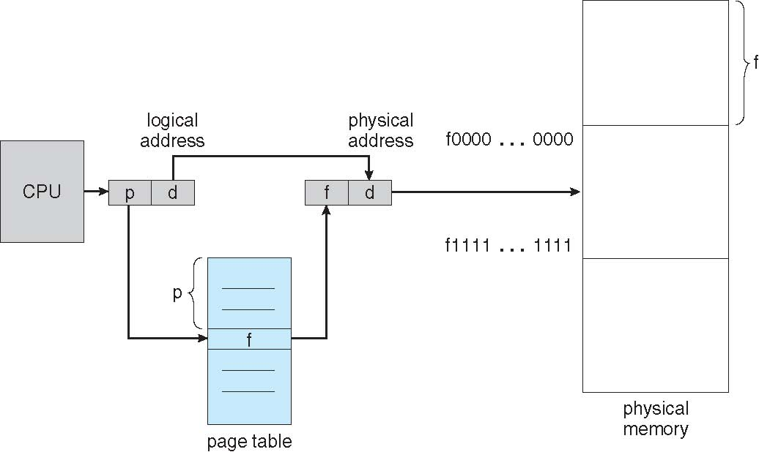
Page Address Translation

Slide 40
Page Address Translation
Page No
Displacement
Frame No
Displacement
Virtual address
Real memory address
Page table
0
1
2
3
4
5
6
Frame no.

Slide 41
Page Address Translation
p d
0101
010110011011
1110
010110011011
Memory address
Converted memory address
Page table
0
1
2
3
4
5
6
0111
1001
0001
1011
0000
1110
0110

Slide 42
Internal Fragmentation
Internal Fragmentation occurs when:
Allocated memory is slightly larger than required memory, and the unused space lies inside the allocated block.
In paging, this happens because:
Pages have fixed size
Process size is not always a multiple of page size
The last page is usually partially filled
Important: Only the last page of a process can cause internal fragmentation.
Why Internal Fragmentation Happens in Paging?
Paging divides memory into equal-sized frames, so:
Even if a process needs 1 extra byte, the OS must allocate one full page
Remaining unused bytes in that page = internal fragmentation

Slide 43
Example: Internal Fragmentation
Given:
Page size = 2048 bytes
Process size = 72,766 bytes
Solution:
Step 1: Calculate Number of Pages Needed
Divide process size by page size:
72,766 ÷ 2,048 = 35.53
Since partial pages are not allowed, round up:
Total pages = 36 pages
This means:
35 pages are fully used
1 page is partially used
Step 2: Calculate Used Bytes in Last Page
Bytes used in last page:
Used bytes = 72,766 − (35 × 2,048)
Used bytes = 72,766 − 71,680
Used bytes = 1,086 bytes
General Formula:
Internal Fragmentation = Page Size − (Process Size mod Page Size)
Step 3: Calculate Internal Fragmentation
Internal Fragmentation:
Internal Fragmentation = Page size − Used bytes
= 2,048 − 1,086
= 962 bytes
Internal Fragmentation = 962 bytes

Slide 44
Worst Case & Average Case Fragmentation
Worst Case Fragmentation:
1 frame − 1 byte
Example:
Page size = 2048 bytes
Process uses only 1 byte in last page
Waste = 2047 bytes
Average Fragmentation:
½ frame size
Example:
Page size = 2048 bytes
Average waste = 1024 bytes
Practice Question:
Page size = 1 KB, process size = 10.5 KB Find internal fragmentation.
Approach:
Convert to bytes
Calculate pages
Subtract used space
Apply formula

Slide 45
Solution: Internal Fragmentation in Paging
Given:
Page size = 1 KB
Process size = 10.5 KB
Step 1: Convert to Bytes
1 KB = 1024 bytes
Process Size:
= 10.5 × 1024 = 10,752 bytes
Step 2: Calculate Number of Pages Required
Number of pages = Process size / Page size
= 10,752 / 1,024
= 10.5 pages
Since a process cannot occupy a fraction of a page:
Total pages allocated = 11 pages
Step 3: Calculate Used Space in the Last Page
Space used by 10 full pages:
= 10 × 1,024 = 10,240 bytes
Remaining data in last page:
= 10,752 − 10,240
= 512 bytes
Step 4: Calculate Internal Fragmentation
Internal Fragmentation = Page size − Used space in last page
= 1,024 − 512
= 512 bytes
Internal Fragmentation = 512 bytes
Direct Solution:
Internal Fragmentation = Page size − (Process size mod Page size)
= 1024 − (10,752 mod 1,024)
= 1024 − 512
= 512 bytes

Slide 46
Page Table Structure
Hierarchical Page Tables
Hashed Page Tables
Inverted Page Tables

Slide 47
Hierarchical Page Tables
Multilevel (Hierarchical) Page Table
Instead of one large page table, the table is divided into multiple levels. Each level points to the next level.
Why it is needed
Reduces memory usage
Allocates page tables only when required
Suitable for sparse address spaces
How it works (Conceptually)
Virtual address is split into:
Outer page number
Inner page number
Offset
Outer table entry points to an inner table
Inner table entry gives the frame number
Key Characteristics
Saves memory compared to single-level paging
Increases address translation time
Commonly used in 32-bit and 64-bit systems
Diagram
Virtual Address
|
v
Outer Page Table
|
v
Inner Page Table
|
v
Physical Frame

Slide 48
Hashed Page Tables
The virtual page number is passed through a hash function to locate the page table entry.
Why it is needed
Efficient for very large address spaces
Reduces size of page table
Works well when virtual addresses are sparse
How it works
Hash(Virtual Page Number) → index
At that index, a linked list of entries may exist
Each entry stores:
Virtual page number
Physical frame number
Pointer to next entry
Key Characteristics
Faster lookup for large address spaces
Hash collisions may occur
Mainly used in 64-bit systems
Diagram:
Virtual Page Number
|
Hash
|
Bucket
/ \
Entry → Entry → NULL

Slide 49
Inverted Page Table
Instead of one page table per process, there is one global page table for the entire system.
Why it is needed
Drastically reduces memory overhead
Page table size depends on physical memory, not virtual memory
How it works
One entry per physical frame
Each entry stores:
Process ID
Virtual page number
To find a page, the system searches the table (usually using hashing)
Key Characteristics
Very memory-efficient
Sharing memory becomes complex
Diagram:
Physical Frame Table
+------------------+
| PID | VPN | Frame|
+------------------+
| P1 | 3 | 0 |
| P2 | 5 | 1 |
| P1 | 8 | 2 |

Slide 50
Segmentation
Segmentation is a non-contiguous memory allocation technique in which:
Segmentation divides a process into variable length chunks called segments
Almost similar to variable sized partitions
Segment’s length is determined by the system
The segments defined by a programmer reflect the modular structure of the process
e.g. data in one segment and code in another segments
Each segment:
Has its own size
Can be placed anywhere in memory
Can grow or shrink independently
Program
├── Code Segment
├── Data Segment
├── Stack Segment
├── Heap Segment

Slide 51
Segment Addressing
The segment address consist of two parts
The segment number s and
The displacement d within that segment
A process segment table entries specify the base address and the segment size
The address conversion process is similar to the paging system
A segmented address reference requires the following steps
Extract the segment number and the displacement from the logical address
Use the segment number to obtain the segment base address and length from segment table
Segment Table
+---------------------------+
| Seg | Base | Limit | Prot |
+---------------------------+
| 0 | 1400 | 1000 | R-X | ← Code
| 1 | 2400 | 800 | RW- | ← Data
| 2 | 3200 | 600 | RW- | ← Stack
| 3 | 4300 | 1200 | RW- | ← Heap
Check that the offset is not greater than the given length; if so, an invalid address is signaled [d < Limit ?] → Invalid
Generate the required physical address by adding the offset to the base address
Physical Address = Base + Offset

Slide 52
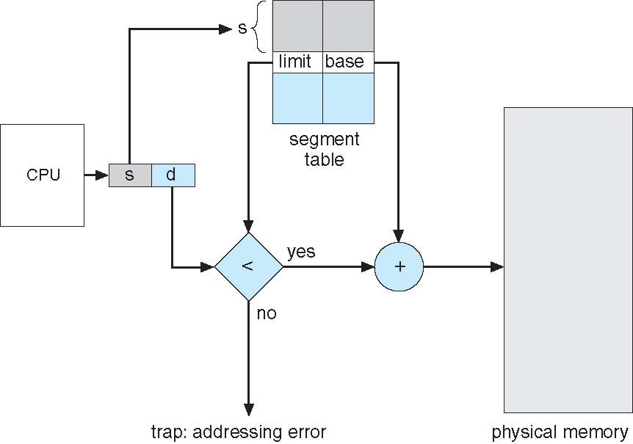
Segment Addressing

Slide 53
Example
Program Example
Suppose a program is divided into 4 logical parts:
Segment Table (Given by OS)
Segment No | Segment Name | Size
0 | Code | 1000 bytes
1 | Data | 600 bytes
2 | Stack | 400 bytes
3 | Heap | 800 bytes
Segment No | Base Address | Limit (Size)
0 | 1400 | 1000
1 | 2400 | 600
2 | 3200 | 400
3 | 4300 | 800
Suppose CPU generates this logical address:
( Segment Number = 1 , Offset = 200 )
Segment 1 → Data segment
Offset 200 → 200 bytes inside data segment

Slide 54
Address Translation Step-by-Step
Step 1: Find Segment Table Entry
Segment 1 → Base = 2400 Limit = 600
Step 2: Check Offset
Offset < Limit ?
200 < 600 (Valid)
Step 3: Calculate Physical Address
Physical Address = Base + Offset
= 2400 + 200
= 2600
Physical Address = 2600
Invalid Address Example
Logical Address:
( Segment = 1 , Offset = 700 )
Check:
700 < 600 (Invalid)
This causes:
Segmentation Fault

Slide 55
Segment Addressing
0
1400
2400
3200
4300
4700
5700
6300
6700
Segment 0
Segment Table
 | Limit | Base
0 | 1000 | 1400
1 | 400 | 6300
2 | 400 | 4300
3 | 1100 | 3200
4 | 1000 | 4700
Segment 3
Segment 2
Segment 4
Segment 1

Slide 56
Segment Address Translation
s d
Physical address
0011
010110011011
0101001001111011
Logical address
Displacement d
+
Segmentation Table
Length | Base Address
010110110111 | 0101000100000001

Slide 57
Practice Example
Given Program Segments
A process is divided into 5 segments as follows:
Segment Table (Given)
Segment No | Segment Name | Size (bytes)
0 | Code | 1200
1 | Data | 800
2 | Stack | 500
3 | Heap | 1000
4 | Library | 700
Segment No | Base Address | Limit
0 | 1000 | 1200
1 | 2500 | 800
2 | 3500 | 500
3 | 4500 | 1000
4 | 6000 | 700
a. Find the physical address for the logical address:
( Segment = 3 , Offset = 600 )
b. Check whether the following logical address is valid or invalid:
( Segment = 2 , Offset = 520 )

Slide 58
Paging vs. Segmentation
Paging use small chunks ‘pages’ of same size
Segmentation use chunks ‘segments’ of variable sizes
Paging avoids fragmentation
Segmentation also improves allocation while preserving the process structure
Paging system is independent of programmer while segmentation reflects the logical structure of a process

Slide 59
Paging and Segmentation
A process can be loaded in separate parts (using segmentation or paging)
Memory address references can be translated dynamically at run time
Not necessary to load all pages of a process into memory
Load portions being referenced at time of execution
Rest is retained on secondary storage

